Slide 1

FRAUD TRANSACTION ALERTING SYSTEM
Subject : Python programming
Subject code : CSA0808
DONE BY:
N.Hari Prakash(192572038)
A.chaatriksai(192571003)
C.Mohammad Asif(192525092)
GUIDE:
Dr. ponmaniraj sambasivam

Slide 2
ABSTRACT
Designed a Python-based system to detect and prevent fraudulent financial transactions.
Digital transactions are growing rapidly, increasing the risk of fraud.
This project aims to detect fraudulent transactions using simple monitoring techniques.
It analyzes user behavior and verifies transactions using authentication and OTP.
The system helps prevent unauthorized access and improves transaction security.

Slide 3
Objectives
Real-Time Transaction Monitoring Monitor every financial transaction instantly.
Fraud Detection Identify suspicious transactions based on amount, location, time, and user behavior.
Risk Classification Categorize transactions as Normal, Suspicious, or Fraudulent.
Instant Alert Generation Notify users immediately when suspicious activity is detected.
OTP Authentication Verify high-risk transactions using a secure One-Time Password (OTP).

Slide 4
INTRODUCTION
Digital transactions are increasing rapidly in today’s world
This also increases the risk of fraud and unauthorized activities
Fraud detection systems help identify suspicious transactions
They analyze patterns like amount, location, and user behavior
Alerts or OTP verification are triggered for risky transactions
Ensures security and protects users from financial loss

Slide 5

LITERATURE REVIEW
Author | Year | Key Ideas | Methodology
Zhang et al. | 2023 | AI-based fraud detection in digital payment systems | Deep Learning (LSTM & Neural Networks)
Sharma & Verma | 2023 | UPI and online banking fraud prevention | Machine Learning with transaction pattern analysis
Kim et al. | 2024 | Real-time fraud detection using Artificial Intelligence | Random Forest and XGBoost algorithms
Patel & Rao | 2025 | Fraud prediction using behavioral analytics | User behavior analysis with anomaly detection
Ahmed et al. | 2026 | Intelligent fraud transaction alerting system | Hybrid AI model with real-time alerts and OTP verification

Slide 6
Problem statement
Problem Statement
Financial fraud has become a major challenge with the rapid growth of digital banking, online payments, and e-commerce. Traditional transaction monitoring systems often fail to detect suspicious activities in real time
Allowing unauthorized transactions to occur and causing significant financial losses.
Many existing systems also lack intelligent analysis of user behavior and effective multi-layer security mechanisms.

Slide 7
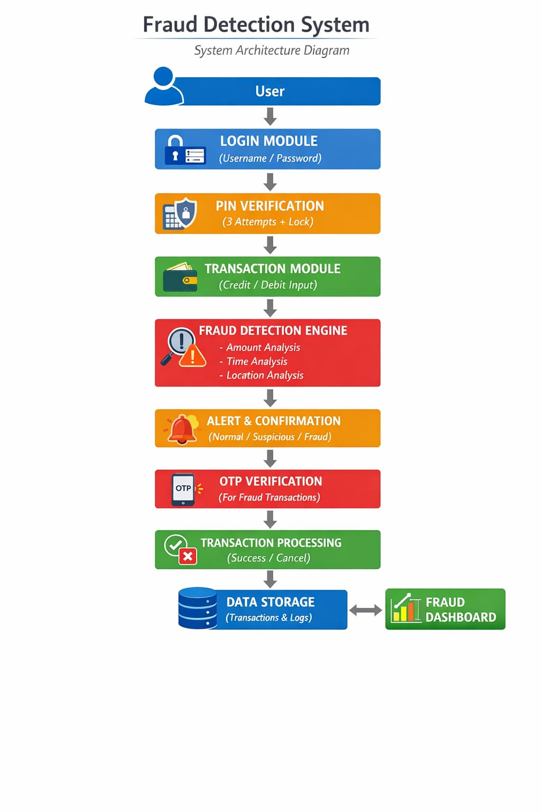
FRAUD DETECTION PROCESS:

Slide 8
MODULE 1: TRANSACTION CHECK
This module collects transaction details entered by the user such as amount, type, location, and category.
It supports both credit and debit transactions to simulate real banking operations.
The system records each transaction in real-time for further processing and analysis.
It maintains a history of transactions which helps in identifying user behavior patterns.
The module ensures that all input data is properly structured before sending it to the detection system.

Slide 9
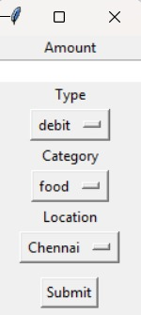
implementation

Slide 10
MODULE 2: FRAUD DETECTION SYSTEM
This is the core module that analyzes each transaction to identify possible fraudulent activities.
It calculates a fraud score based on factors like transaction amount, time, and location changes.
The system detects unusual patterns by comparing current transactions with past user behavior.
It classifies transactions into normal, suspicious, or fraudulent categories.
The module works in real-time to ensure immediate detection of risky transactions.

Slide 11
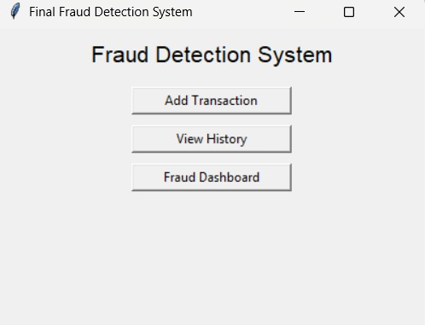
implementation

Slide 12
MODULE 3: ALERT AND OTP MODULE
This module generates alerts whenever a transaction is detected as suspicious or fraudulent.
It asks the user for confirmation before allowing the transaction to proceed.
An OTP (One-Time Password) is generated for secure verification of the transaction.
The user must enter the correct OTP to successfully complete the transaction.
If the OTP is incorrect, the transaction is immediately cancelled to prevent misuse.
This module adds an extra layer of security to protect user accounts from unauthorized access.

Slide 13
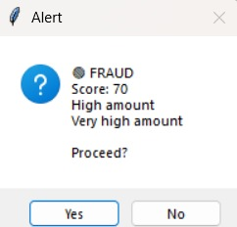
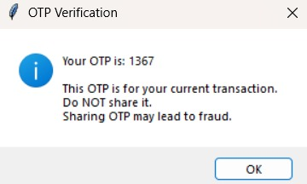
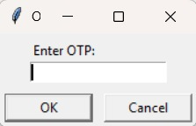
implementation

Slide 14
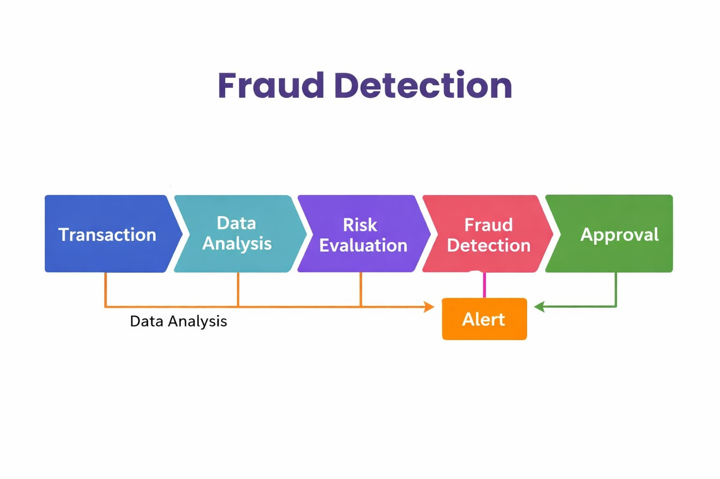
INTEGRATION
The Transaction Module collects transaction details like amount, type, and location from the user.
This data is immediately sent to the Fraud Detection Module for analysis.The Fraud Detection Module checks for unusual patterns and calculates the fraud risk.
If the transaction is normal, it is processed without interruption.
If the transaction is suspicious or fraudulent, it is passed to the Alert & OTP Module.
The Alert & OTP Module sends an alert and asks for OTP verification before completing the transaction.

Slide 15
References:
Zheng ,“ Transaction fraud detection based on total order relation and behavior diversity." IEEE Transactions on Computational Social Systems 5.3 (2023): 796-806.
L., Liu, G., Transaction fraud detection based on total order relation and behavior diversity. IEEE Transactions on Computational Social Systems, 5(3), 796-806.
Guanjun Liu,. "Transaction fraud detection based on total order relation and behavior diversity." IEEE Transactions on Computational Social Systems 5, no. 3 (2022): 796-806.
Jiang, C., 2023. Transaction fraud detection based on total order relation and behavior diversity. IEEE Transactions on Computational Social Systems, 5(3), pp.796-806.

Slide 16
Conclusion
The Fraud Transaction Detection System successfully identifies suspicious and fraudulent activities using real-time analysis.
It enhances security through multi-level authentication, including PIN verification and OTP validation.
The system helps in preventing unauthorized transactions and protecting user data.
With features like alert mechanisms and account locking, it improves reliability and user trust.
This project can be further extended and implemented in real-world banking systems for advanced security and fraud prevention.

Slide 17
Thank you

